Slide 1
Classifying and Finding Similarities in Architectural Styles
CSE 495 – Second Presentation
Emirkan Burak Yılmaz
Project Supervisors:
Prof. Dr. Yusuf Sinan Akgül, Dr. Funda Tan
20/12/2023

Slide 2
Contents
Project Description
Dataset Overview
Addressing Noise in the Dataset
Data Augmentation
CNN Architecture
Training and Evaluation
Fine-tuning VGG-16
Fine-tuned VGG-16 Evaluation
Project Roadmap
Optimization Strategies
References

Slide 3
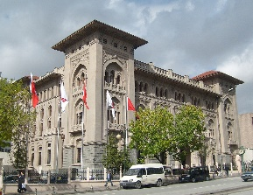
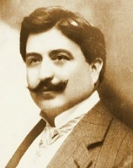
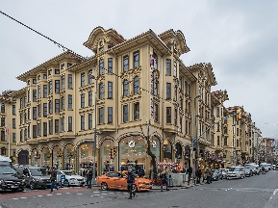
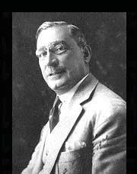

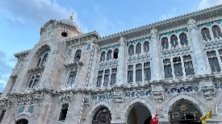
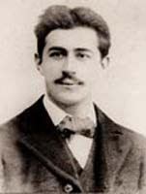
Project Description
We explore the power of deep learning and computer vision to identify architectural style similarities and classify architects based on their distinct design characteristics.
First Ziraat Bank Headquarters
Mimar Kemalettin
Tayyare Apartments
Giulio Monger
Grand Post Office
Vedat Tek

Slide 4
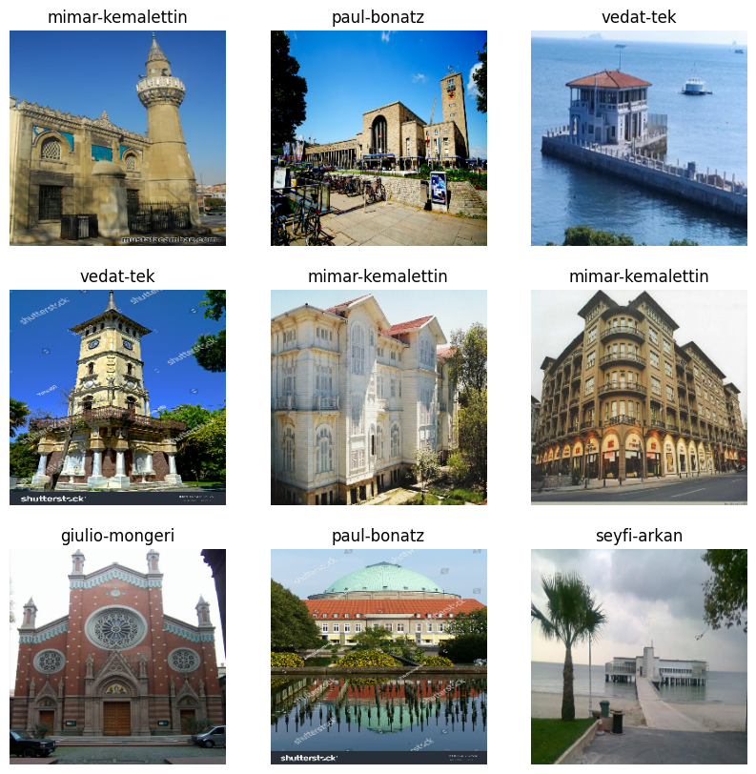
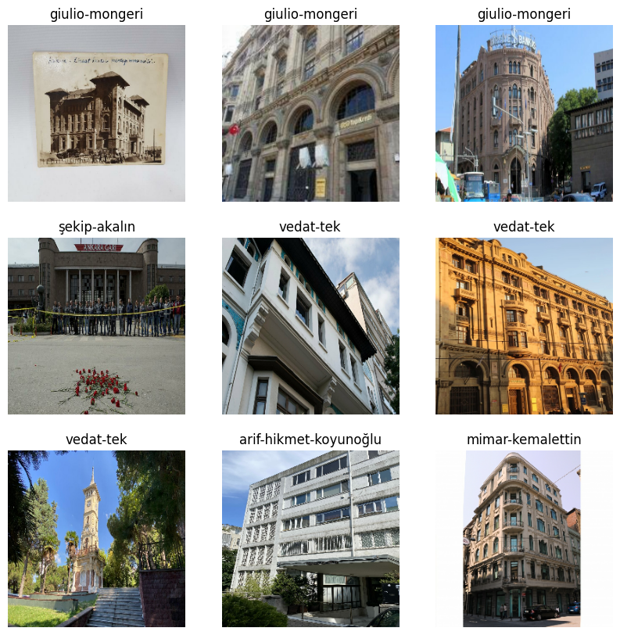
Dataset Overview
2412 images belonging to 15 classes
https://huggingface.co/datasets/ebylmz/architects
Notes:
Images are gathered through web scraping techniques, followed by a preprocessing step aimed at minimizing noise within the collected data.

Slide 5
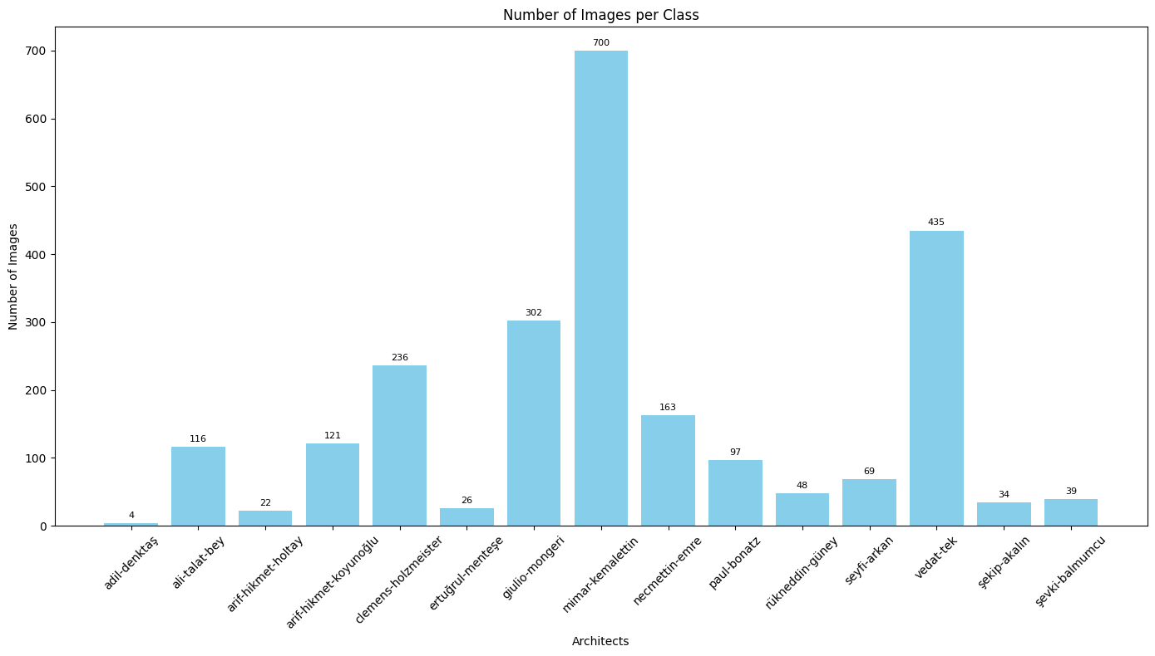
Dataset Overview
Notes:
Notable class imbalance is evident in the dataset, a consequence of the varying quantity of works among different architects, highlighting the inherent nature of the data.

Slide 6
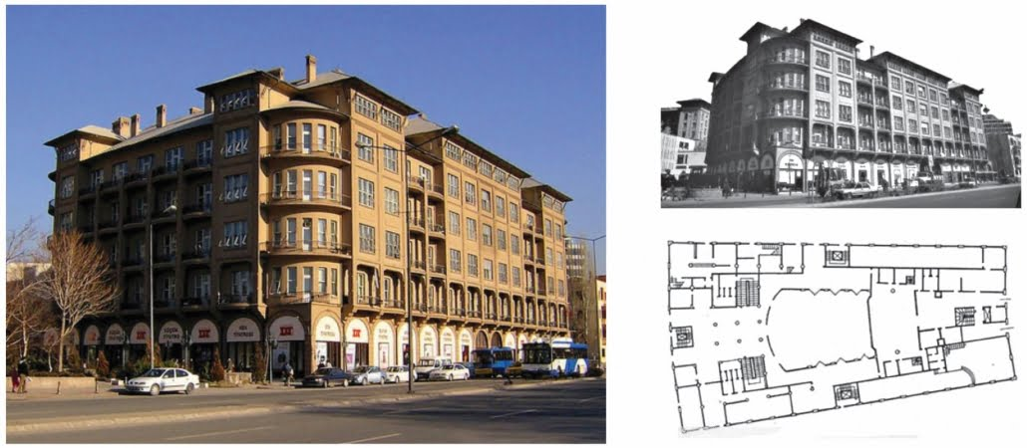
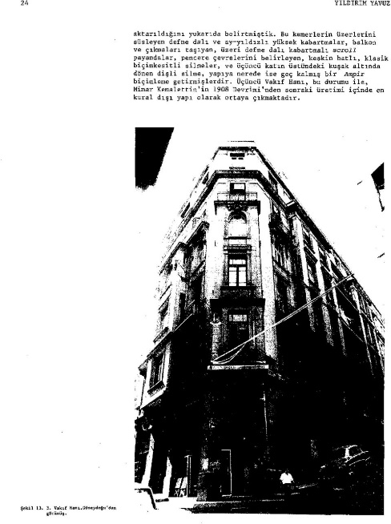
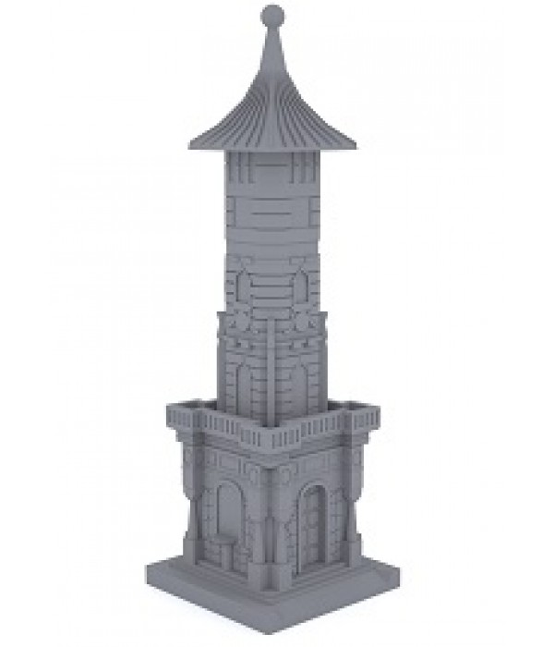
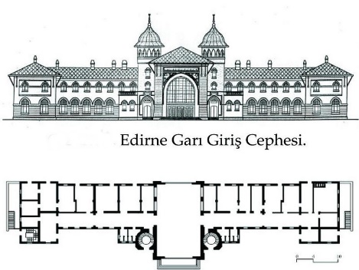
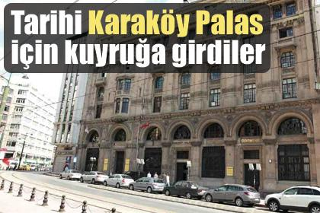
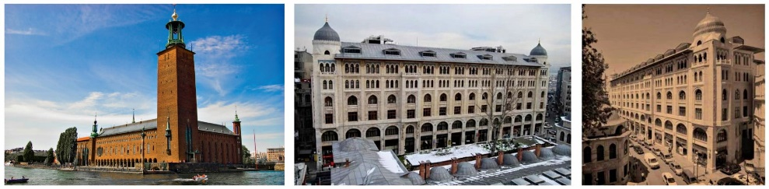
Addressing Noise in the Dataset
Notes:
News headings, Architectural design, Old pictures, Collage

Slide 7
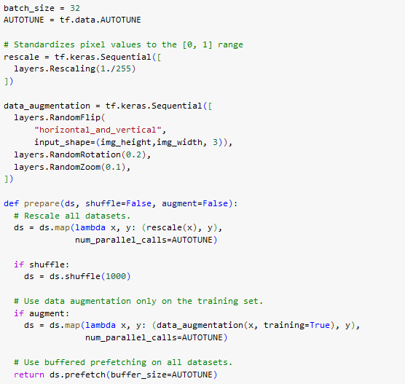
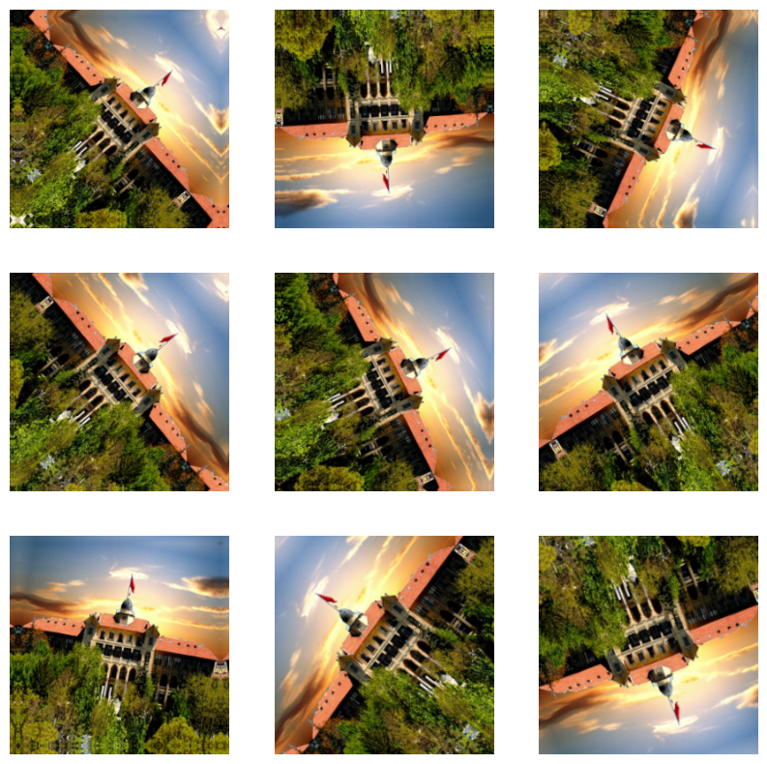
Data Augmentation

Slide 8
Training and Evaluation Strategies
Progressive Complexity in CNN Architecture
Begin with a simple CNN architecture.
Systematically increase the complexity according to results on tested on both our dataset and an external dataset
Fine-tuning
Initialize VGG-16 pre-trained on ImageNet.
Freeze initial layers; train with augmented data.

Slide 9
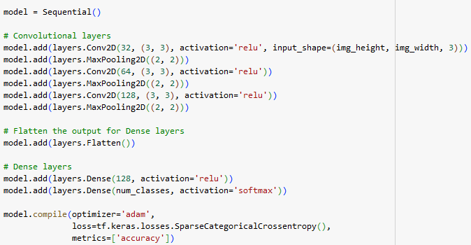
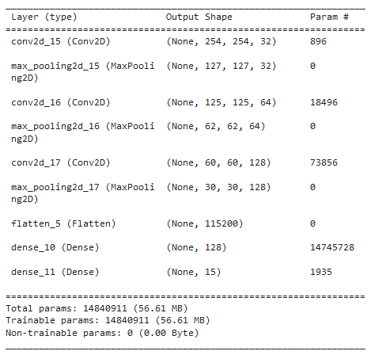
CNN Architecture

Slide 10
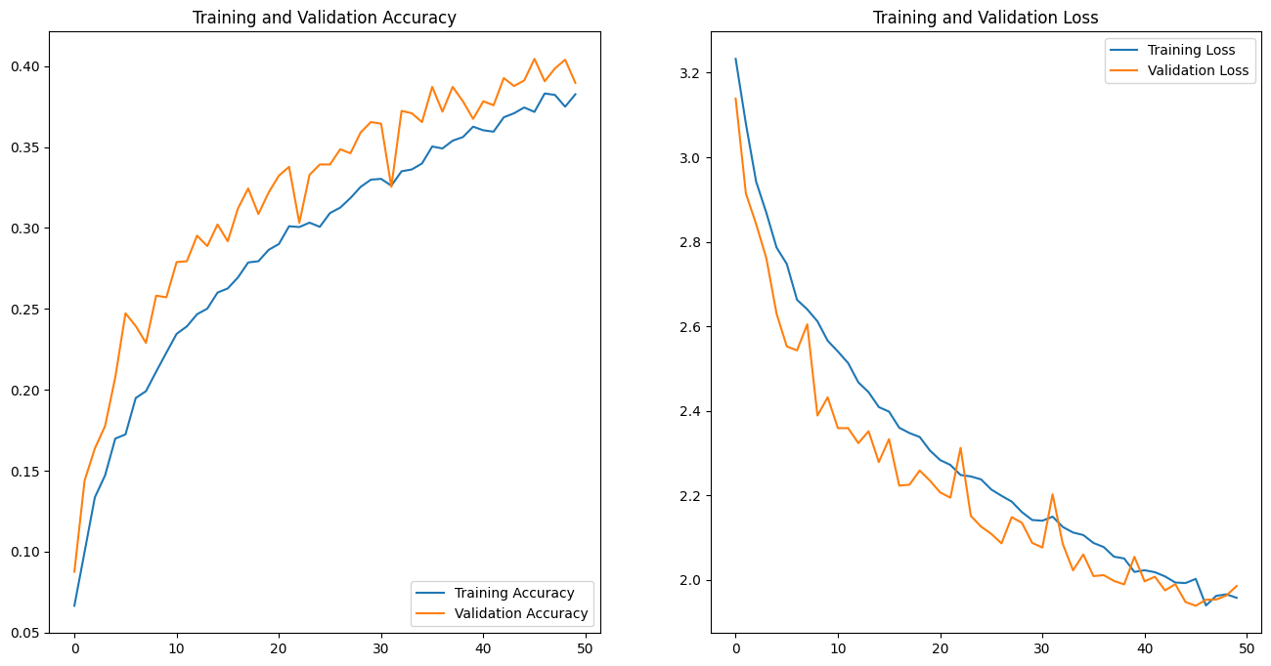
Training and Evaluation - 1
Test on external dataset (20 epoch)
Dumitrux (2020) Architectural styles, Kaggle
Notes:
Note that training is only done for 20 epoch

Slide 11
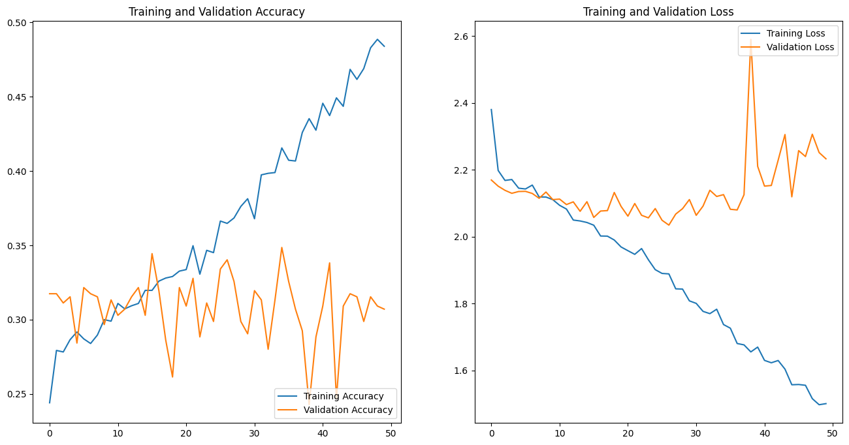
Training and Evaluation - 2
Training on our dataset (50 epoch)
Notes:
Discuss the problem

Slide 12
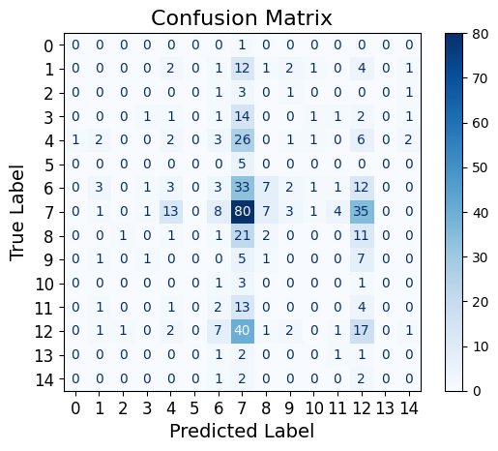
Training and Evaluation - 2
Notes:
Discuss the problem

Slide 13
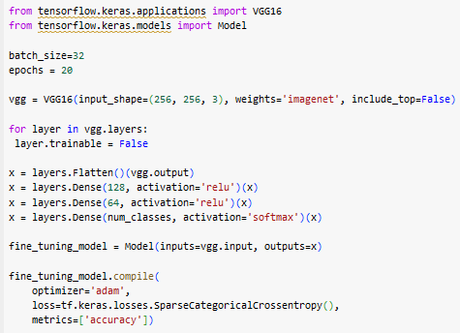
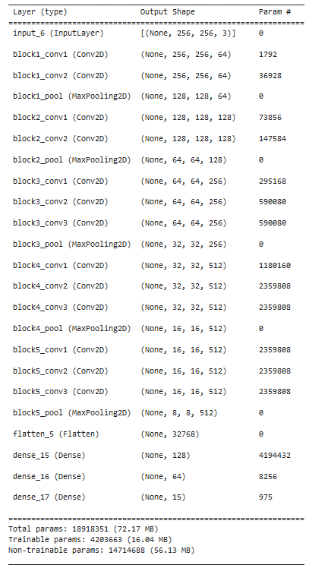
Fine-tuning VGG-16

Slide 14
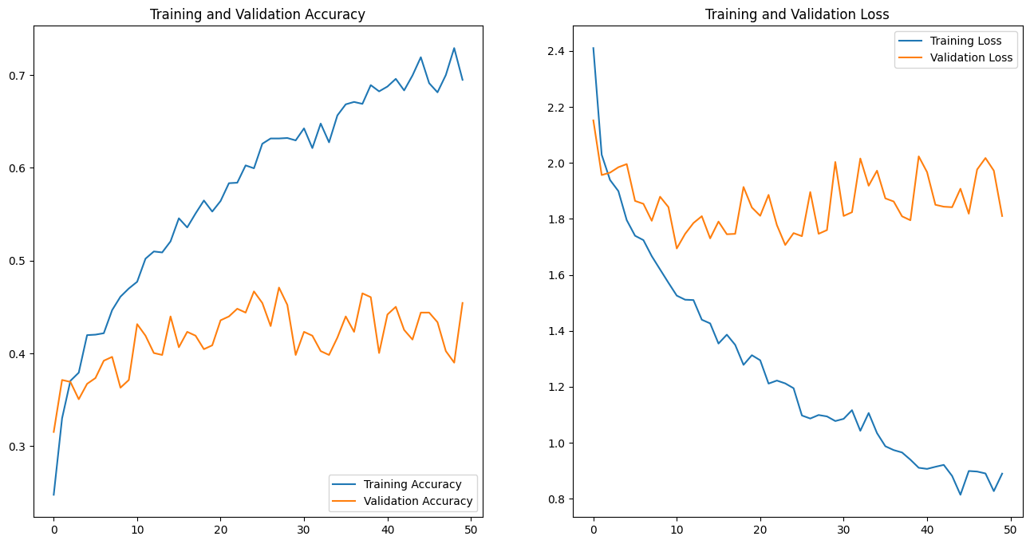
Fine-tuned VGG-16 Evaluation
Fine-tuned VGG-16 on our dataset (50 epoch)
Notes:
Discuss the problem

Slide 15
Optimization Strategies
Grid Search for hyperparameter tuning
Learning rates, optimizer types, dropout rates, batch sizes, etc
Additional data
Incorporate diverse data sources (e.g., Google Street View) to augment the dataset, enhancing model robustness and performance.

Slide 16



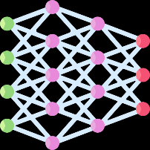

Project Roadmap
Data Collection 06/11/23 - 20/11/23
20/11/23 - 4/12/23 Preprocessing
&
Splitting the Data
Architectural Style Clustering
08/01/24 - 15/01/24
25/12/23 - 08/01/24
Performance Evaluation
&
Hyperparameter Tuning
Model
Building & Training
4/12/23 - 25/12/23

Slide 17
References
Yoshimura, Y., Cai, B., Wang, Z. and Ratti, C., 2019. Deep learning architect: Classification for architectural design through the eye of artificial intelligence. Computational Urban Planning and Management for Smart Cities 16, pp.249-265.
Zhang, M., Cui, Z., Neumann, M. and Chen, Y., 2018, April. An end-to-end deep learning architecture for graph classification. In Proceedings of the AAAI conference on artificial intelligence (Vol. 32, No. 1).
Pesto, C., 2017. Classifying US Houses by Architectural Style Using Convolutional Neural Networks.
Wang, B., Zhang, S., Zhang, J. and Cai, Z., 2023. Architectural style classification based on CNN and channel–spatial attention. Signal, Image and Video Processing, 17(1), pp.99-107.
Dumitrux (2020) Architectural styles, Kaggle. Available at: https://www.kaggle.com/datasets/dumitrux/architectural-styles-dataset.
İcons: Flaticon.com

